Slide 1
Nuclear Fuel Performance
NE-533
Spring 2024

Slide 2
Upcoming
Paper presentations next time
Upload presentations by end of the day March 20
Will do random number draw to assign presentation order

Slide 3
MOOSE Project
MOOSE part 1 notes/grade have been emailed back everyone
I realized that the MOOSE project grading delineation was not clear in the syllabus
Part 1: 20%, Part 2: 30%, Part 3: 50%
Since this was not included previously, I need agreement
Bear in mind later parts factor in the accuracy of earlier parts
Some notes
Do mesh convergence testing! A finer mesh is not always the answer
These are reports we are writing, make them such, subsections and so on
Do all of the assigned parts
Ask questions and come talk to me!

Slide 4
Last time
Five families of fission products, which change the fuel behavior
soluble oxides, insoluble oxides, noble metals, volatiles, noble gases
Fission gas is released in three stages
Fission gas production and diffusion to grain boundaries
Grain boundary bubble nucleation, growth, and interconnection
Gas transport through interconnected bubbles to free surfaces
Fission gas release models are used to understand fission gas experiments and to predict gas release for fuel performance codes
Spherical grain models predict a fraction of gas release for post-irradiation annealing or for in-pile gas release
Booth model takes Stage 1 into account

Slide 5
Modeling in-pile release
The initial gas concentration is 0
Gas is produced due to fission, where y is the chain yield (y = 0.3017 for Xe and Kr) and the fission rate
Gas can also decay, where λ is the decay constant
If we only consider stable stable products, λ = 0
For in pile release, the fraction is equal to
After solving with with a Laplace transform
The total gas production is gas atoms/cm³
Release
Gas atoms
Grain boundary
ICs and BCs
c_{g}(r, 0) = 0
c_{g,r}(0, t) = 0
c_{g}(a, t) = 0 (release)

Slide 6
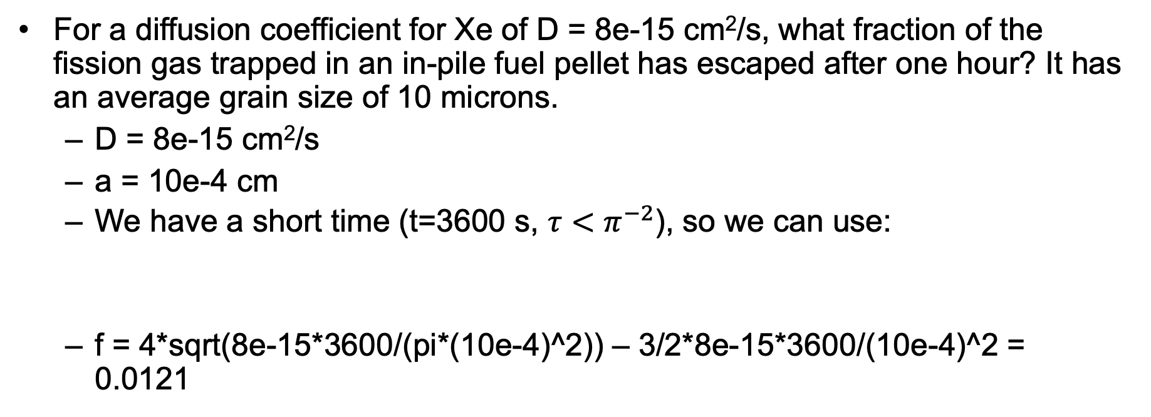
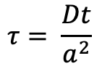
Example
For a diffusion coefficient for Xe of D = 8e-15 cm²/s, what fraction of the fission gas trapped in an in-pile fuel pellet has escaped after one hour? It has an average grain size of 10 microns.
D = 8e-15 cm²/s
a = 10e-4 cm
We have a short time (t=3600 s, $τ<π^{−2}$), so we can use:
f = 4*sqrt(8e-15*3600/(pi*(10e-4)^2)) – 3/2*8e-15*3600/(10e-4)^2 = 0.0121
$$τ= \frac{Dt}{a^{2}}$$

Slide 7
As time progresses, both the fraction released and the produced gas increase

Slide 8
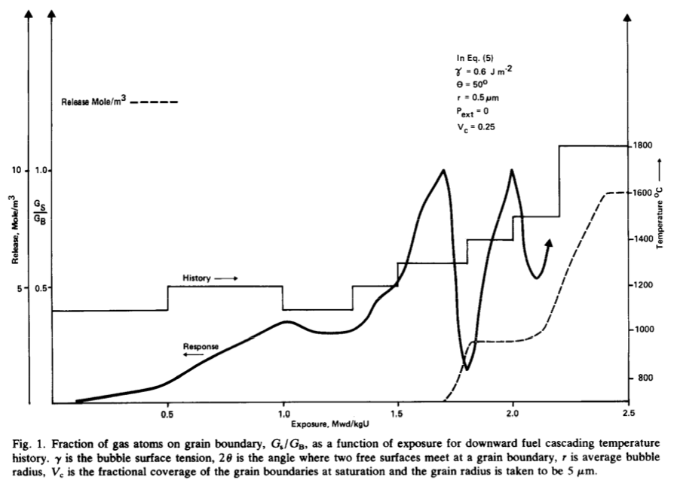
Forsberg-Massih model
The Booth model ONLY considers stage one of fission gas release
Two stage Forsberg-Massih mechanistic model
Considers intragranular diffusion diffusion to grain boundaries (stage 1)
Also, grain boundary gas accumulation, resolution back into grain, saturation (stage 2)
Assumes that once the bubbles on the grain face are interconnected, it is released (no stage 3)

Slide 9
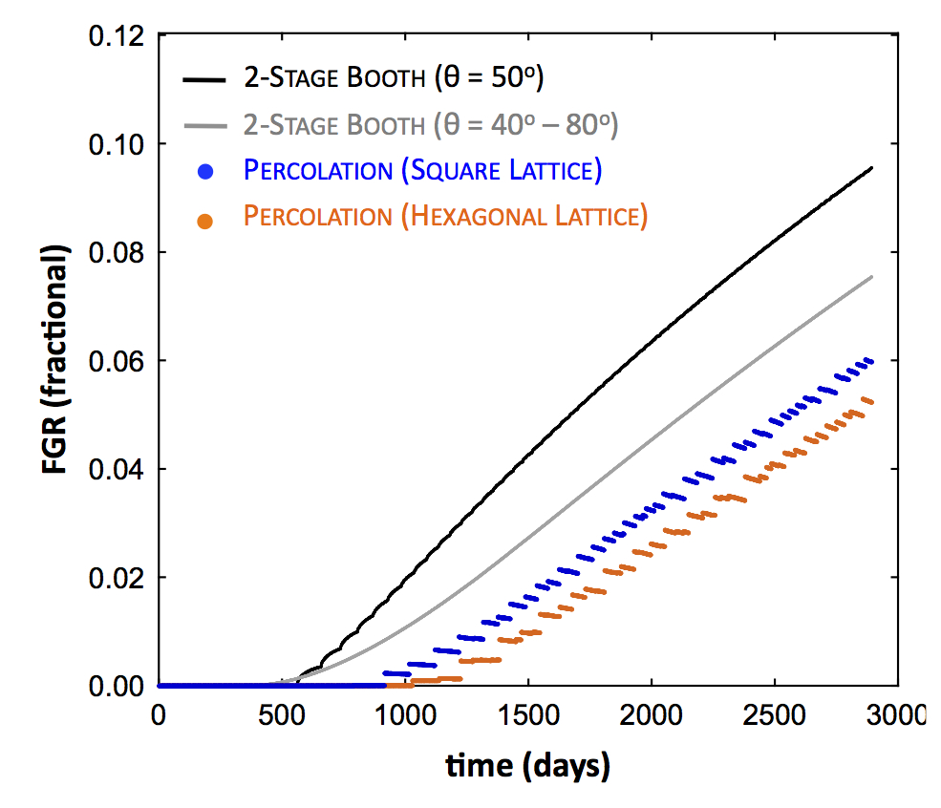
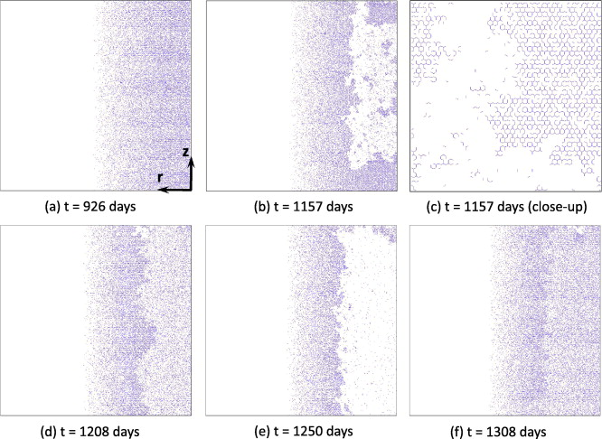
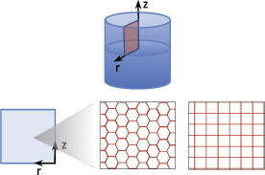
Forsberg-Massih model
2-stage F-M model over-predicts gas release because it neglects grain boundary bubble percolation (Stage 3)
Millett, Tonks, and Biner. JNM, 424.1 (2012): 176-182.

Slide 10
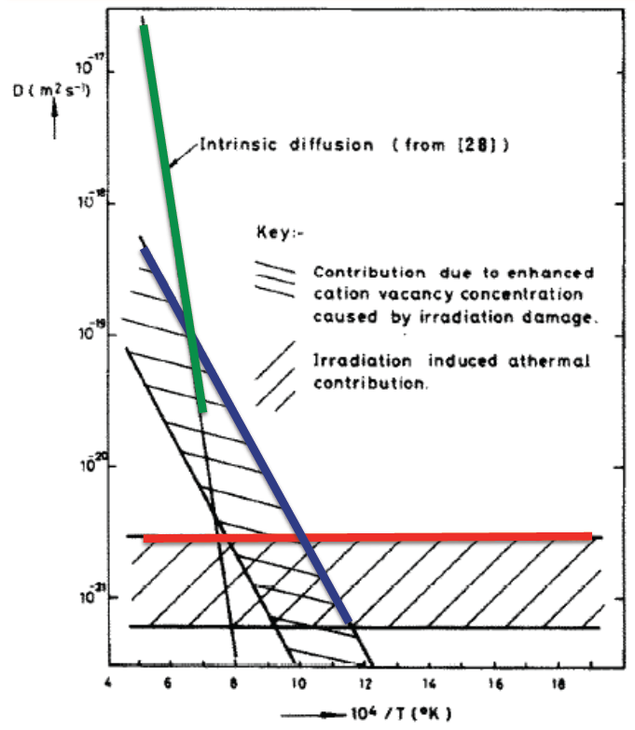
Gas diffusion
The diffusivity of the fission gas depends on temperature and on irradiation
Experimental data shows three different regimes for the diffusivity
D = D₁ + D₂ + D₃ cm²/s

Slide 11
Gas diffusion
The effective fission gas diffusivity is slower due to trapping by intragranular bubbles
As the gas atoms diffuse towards the grain boundary, some are trapped by the small intragranular bubbles
Some are later knocked out by energized particles (called resolution)
The effective diffusion constant depends on the trapping rate r_{t} and the resolution rate r_{r}

Slide 12
Fuel Swelling/Dimensional Change

Slide 13
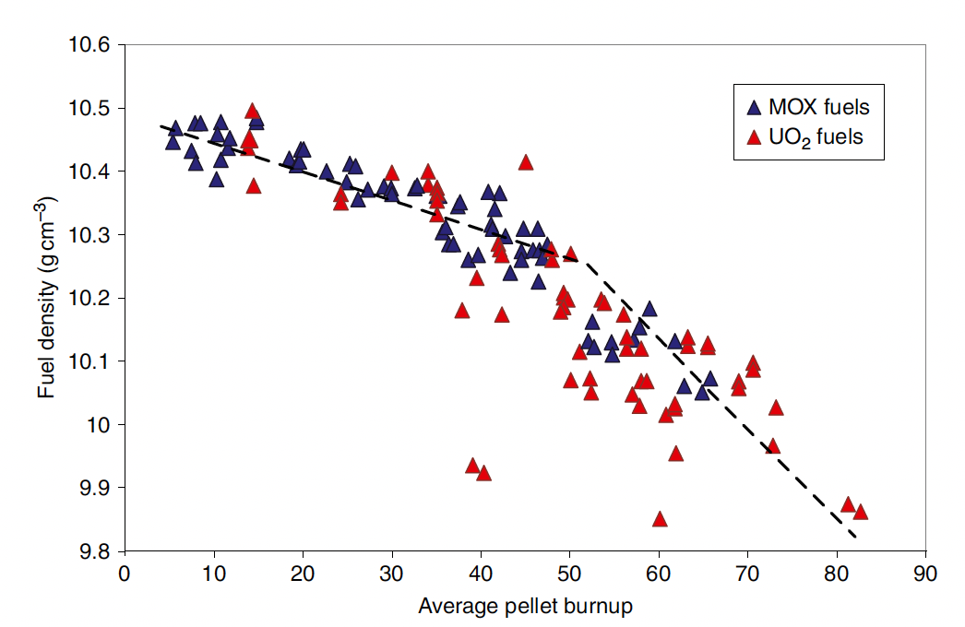
Fuel changes size and shape under reactor operation
Thermal expansion:
increase in volume, decrease in density, caused by increasing temperature
Densification:
Decrease in volume, increase in density, caused by shrinking of porosity left after sintering
Swelling:
Increase in volume, decrease in density, caused by fission products
Irradiation Creep:
Change in shape, constant density, occurs with applied stress less than σ_{y}

Slide 14
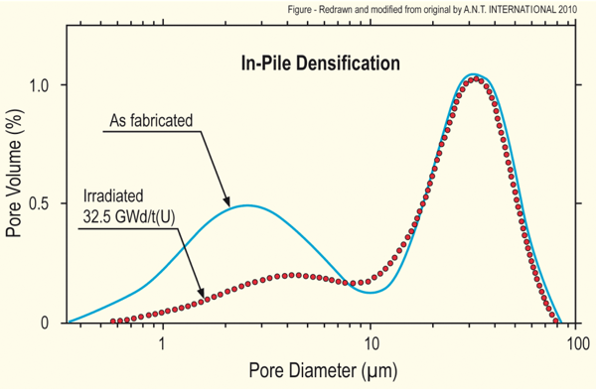
Densification
Densification takes place during initial 5 - 10 MWd/kgU
Small, as-built pores close due to effects of fission spikes and vacancy diffusion
Large pores stable (in absence of large hydrostatic stress)
Empirical correlation for densification is a function of
β - Burnup (in FIMA)
Δρ₀ – Total densification that can occur (a common value is 0.01)
β_{D} – Burnup at which densification stops ( a common value is 5 MWD/kgU)
C_{D} = 7.235 − 0.0086 (T(°C) − 25) for T < 750°C and CD = 1 for T ≥ 750 °C
[Maier et al, 1988]

Slide 15
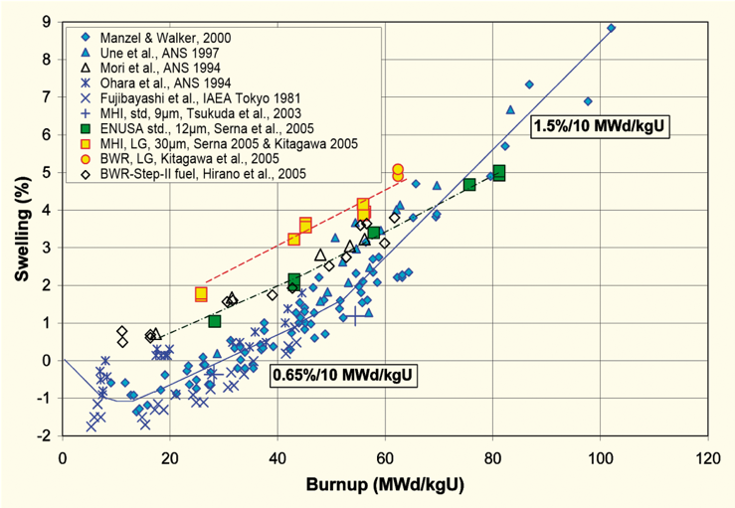
Fission product induced swelling
Fission product swelling results from three changes in the fuel microstructure
Solid swelling: Accumulation of soluble and insoluble fission products in fuel matrix
Gaseous swelling: Accumulation of gaseous and volatile fission products in intragranular and intergranular pores
High burnup swelling: Restructuring of pellet rim with the accumulation of fission gas in a large number of small pores
after Garzarolli in [Rudling et al, 2007]

Slide 16
Solid fission product swelling
The solid fission product swelling model is a function of:
β – Burnup (in FIMA)
ρ – Initial UO₂ density (g/cm³)
Includes contributions from soluble oxides, insoluble oxides, and metallic precipitates

Slide 17
Gaseous fission product swelling
Gaseous swelling varies strongly with temperature, fission rate and stress
T < 1000K
Fission gas atoms remain in fuel matrix or collect in small, isolated, intragranular pores (<1 nm)
Intragranular pore size limited by fission spikes that drive gas back into fuel matrix
Gaseous swelling constrained by fission gas release
T = 1000 to 1700 K
Swelling takes place at hot interior of pellet
Gas atoms in fuel matrix diffuse to grain boundaries and collect in pores
Gas pressure causes bubbles to increase in size and to coalesce into larger pores
Gaseous swelling opposed by applied stress
Gaseous swelling also constrained by fission gas release

Slide 18
The overall swelling behavior depends on temperature

Slide 19
Total change in volume
The total change in volume is found by adding all components of dimensional change
ε_{tot} = ε_{th} + ε_{D} + ε_{sfp} + ε_{gfp}
Example:
fission rate = 2.5e13 f/(cm³ s)
T(fuel) = 1400 K
T_{ref} = 300 K
For densification: Δρ₀ = 0.01 and β_{D} = 5 MWD/kgU
Total time: 2 weeks

Slide 20
Example

Slide 21
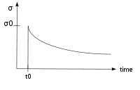
Creep
Creep is a general mechanism for plastic deformation that occurs over time when σ < σ_{y}
Consider a heated metal beam so it expands some distance dx
We then fix it between two walls and let it cool down
Because σ < σ_{y}, that stress remains constant
In creep, defect diffusion is induced by the stress to cause permanent deformation and reduce the stress
Therefore, creep
Occurs over time
Increases with increasing number of diffusing defects
High temperature (thermal creep)
Irradiation (irradiation creep)
x
x+dx
σ = E ε

Slide 22
Creep
General creep equation:
Creep can be caused by various microstructural mechanisms
Bulk Diffusion (Nabarro-Herring creep)
Atoms diffuse (high T), causing grains to elongate along the stress axis
Q = Q(self diffusion), m = 1, and b = 2
Grain boundary diffusion (Coble creep)
Atoms diffuse along grain boundaries to elongate the grains along the stress axis
Q = Q(grain boundary diffusion), m = 1, and b = 3
Dislocation creep
Dislocations glide under a high stress
Dislocations climb due to defects to avoid obstacles
Q = Q(self diffusion), m = 4–6, and b = 0

Slide 23
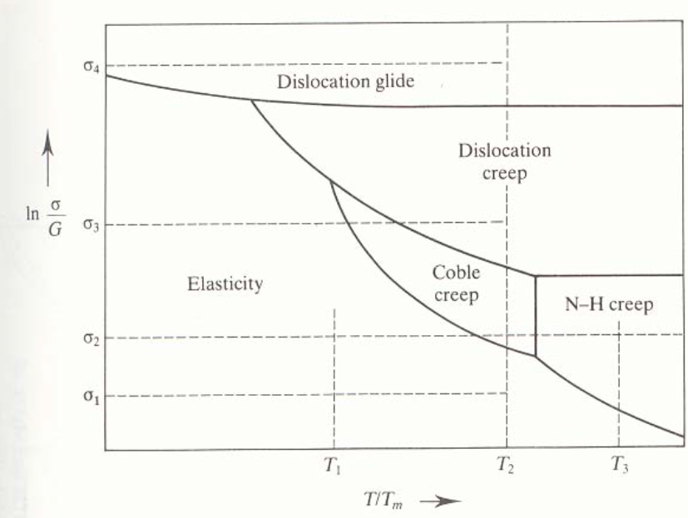
Different creep mechanisms are active for different combinations of stress and temperature

Slide 24
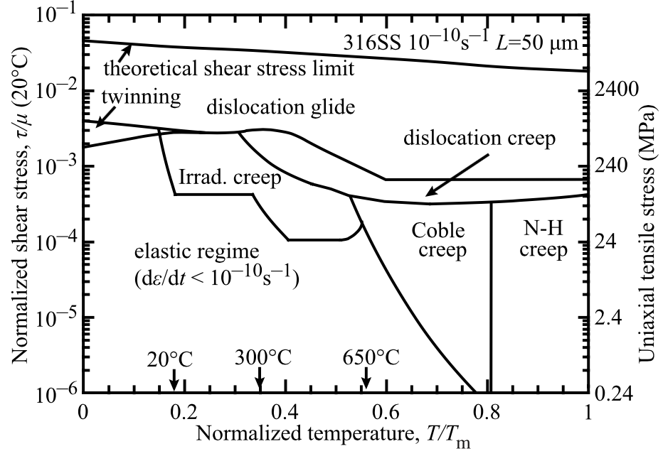
The behavior of creep changes in irradiated materials

Slide 25
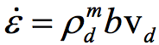
Irradiation and Creep
Irradiation accelerates creep, causing it to be significant at lower temperatures
Irradiation has little effect on diffusional creep, but it accelerates dislocation creep in cubic materials
The dislocation creep rate can be written as
ρ_{d}^{m} is the density of mobile dislocations
b is the burgers vector
v_{d} is the dislocation velocity
Gliding dislocations quickly get pinned by obstacles
As the dislocations absorb defects created by irradiation, they climb to different slip planes to avoid the obstacles
More interstitials are absorbed than vacancies due to the higher sink strength for interstitials

Slide 26
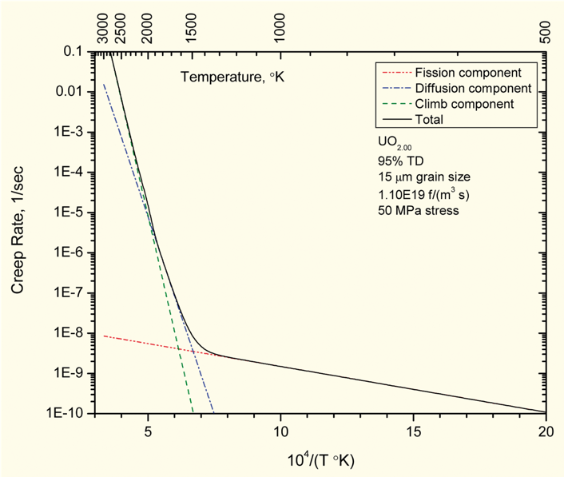
Fuel Creep
Like other materials, the fuel also undergoes creep
The fuel creep (In UO2) is a combination of diffusion creep and irradiation creep
It is expected that fuel creep plays a major role in dimensional change in metallic fuels, largely via N-H and Coble creep, but still unproven experimentally and no good creep models exist for metallic fuels

Slide 27
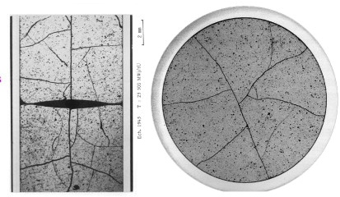
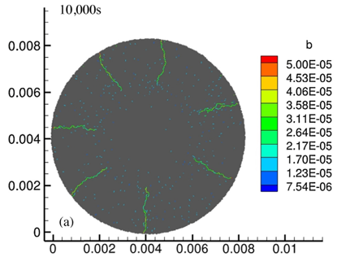
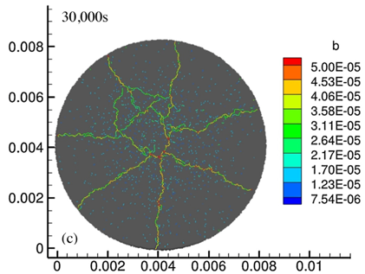
Fracture
UO₂ pellets fracture during changes in temperature due to large thermal stresses
Fracture results in:
Increased gap reduction
Reduced thermal conductivity
Increased avenues for fission gas release
Fracture has been typically modeled in two ways:
Empirical relocation model that is a function of burnup
Semi-empirical smeared cracking model
Modern methods provide means of modeling discrete cracks
Radial cracks partially penetrate the pellet during temperature increase
Full cracking occurs when the temperature decreases

Slide 28
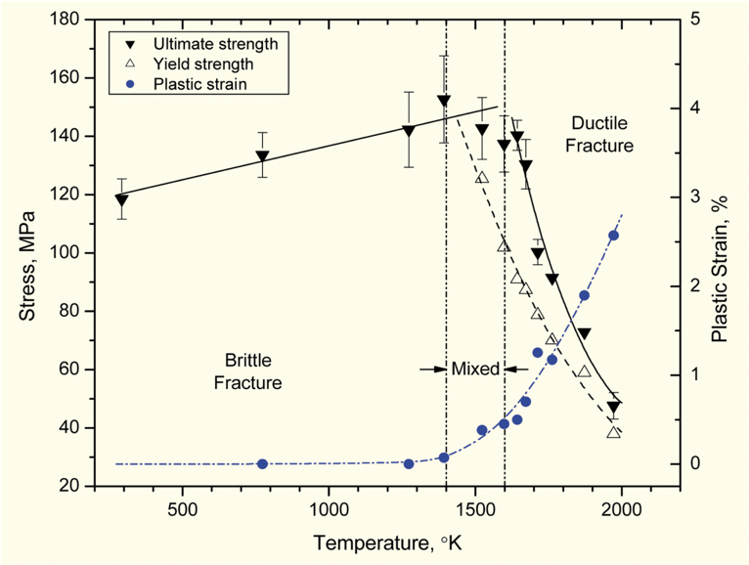
Fracture
The fracture behavior of the fuel is fairly complicated
Fracture strength varies with grain size (G)
σ_{frac} = G^{-m}σ_{frac, ref}, m = 0.04 – 0.05 (vs. m ~ 0.5 for metal)
Increasing grain size from 10 μm to 100 μm reduces σ_{frac} by ~10%
Ductility transition temperature is lower in-reactor than in thermal tests
Fracture strength is ~10× higher in compression than in tension
Load-deformation behavior strongly affected by creep under in-reactor conditions

Slide 29
Summary
Many materials models for fuel are empirical and correlated to burnup
Fuel pellets change shape due to
Thermal expansion (increase in volume)
Densification (decrease in volume)
Swelling (increase in volume)
Creep (volume stays the same)
Fracture also decreases the gap, as fractures pieces shift outward

